Slide 1
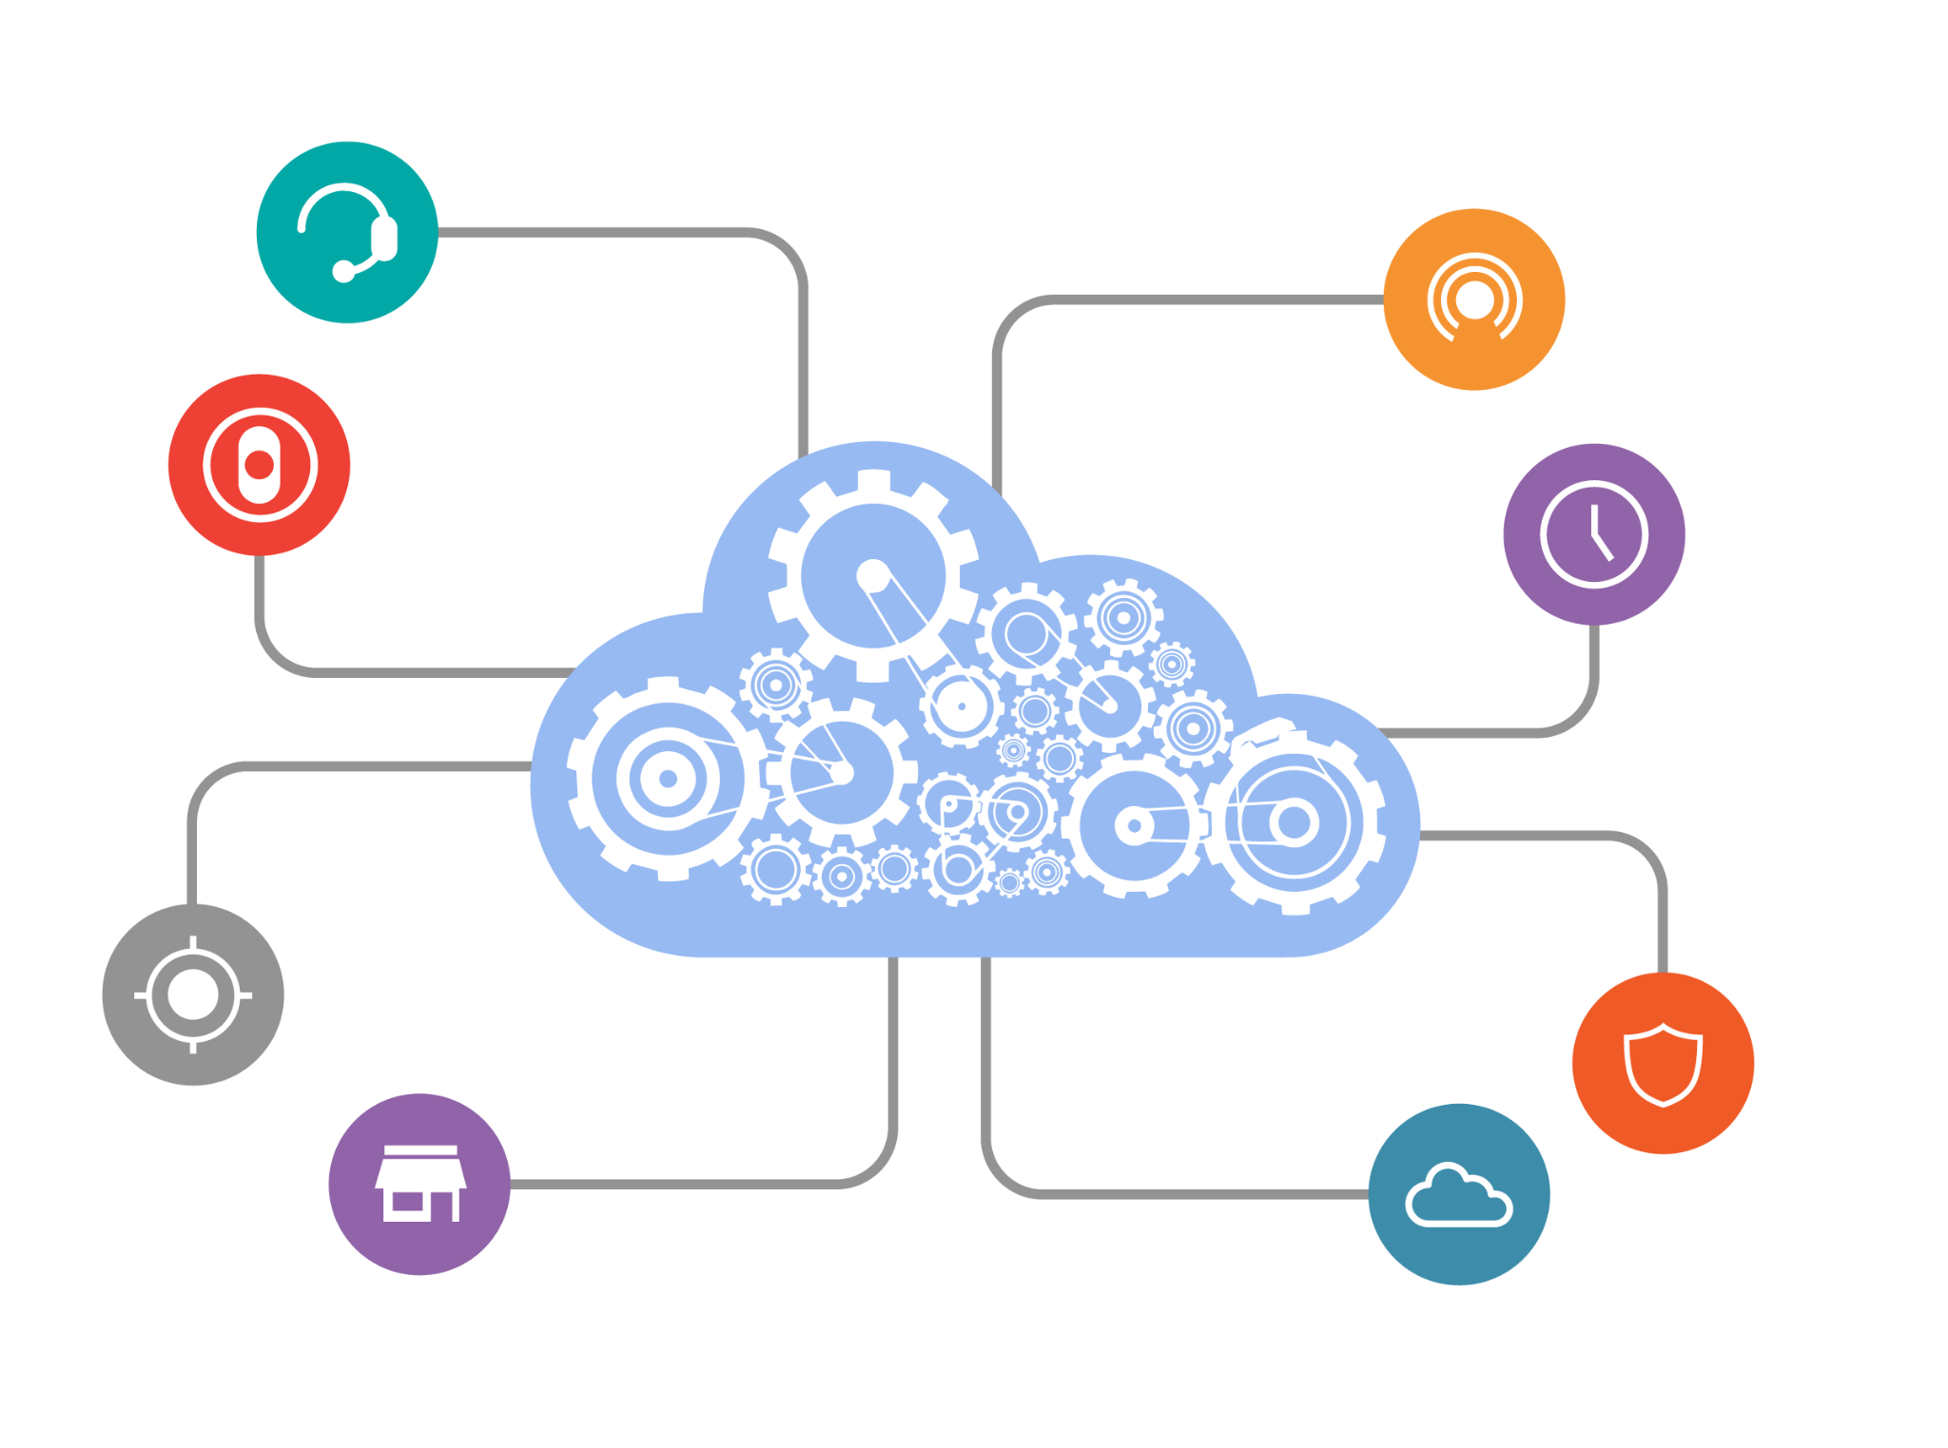
How to Create an API Including Security Measures
Joanne Yong, Zion Castillo

Slide 2
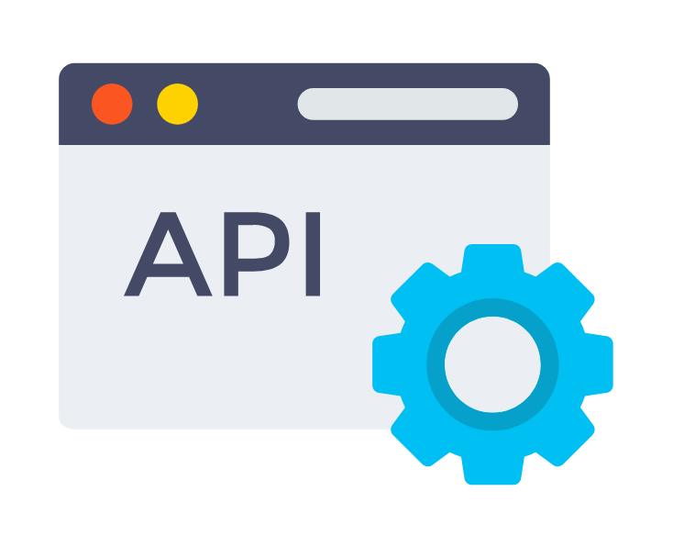
What is an API?
API- Application Programming Interface
Mechanisms that allow various software components to communicate with one another by defining and enforcing a set of rules and protocols.
Set of functions and procedures that allow for the creation of applications.
They access the data and features of other applications, services, or operating systems.
Middleman for different software platforms.
Allows two unrelated applications to “talk” to each other.
Similar to legos.
Provides building blocks which make software development easier.

Slide 3
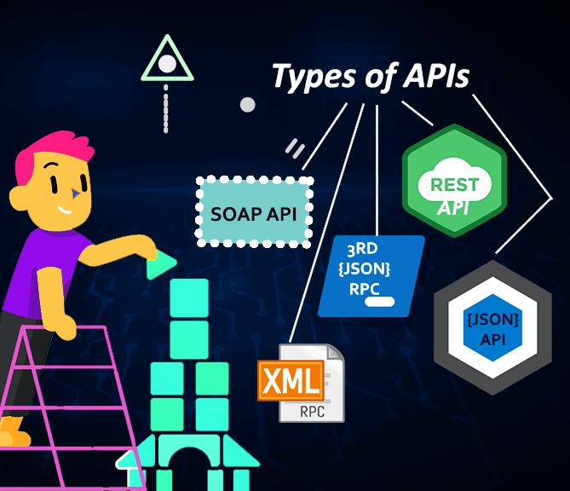
API Types
Public: open for public use.
no authorization or cost
sometimes moderate authentication, authorization or monetization
Partner: only accessible by authorized external developers to aid business-to-business partnerships
stronger authentication, authorization and security mechanisms; no direct monetization
Internal/Private: internal to an enterprise and only used for connecting systems and data within the business.
weak security and authentication
Composite: combine two or more different APIs to address complex system requirements or behaviors / craft a sequence of related or interdependent operations.
improve speed and performance over individual APIs

Slide 4
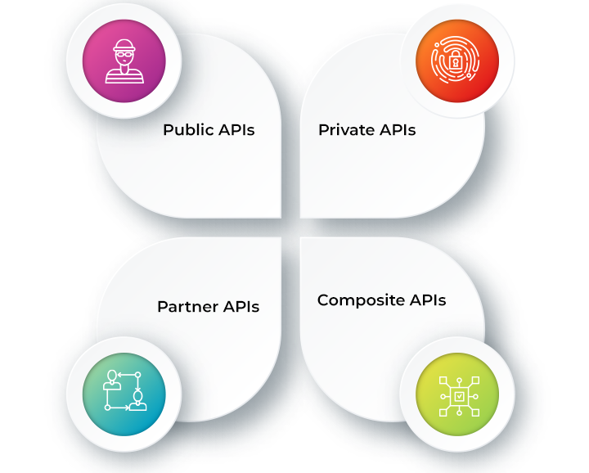
API Protocols and Architectures
REST: Representational State Transfer
GET, POST, PUT, DELETE
client sends requests to the server as data → server uses input to start internal functions and returns output data back to the client
SOAP: Simple Object Access Protocol
Client and server exchange messages using XML
RPC: Remote Procedure Calls
client completes a function on the server → server sends the output back to the client.
Websocket: uses JSON objects to pass data
supports two-way communication between client apps and the server

Slide 5
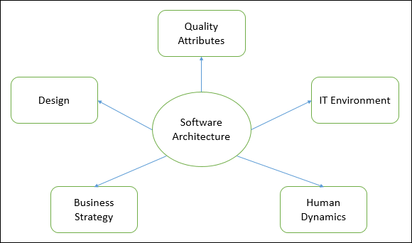
APIs vs Other Software Architectures
Software Architectures represents the design decisions related to overall system structure and behavior.
Software Architecture Patterns:
Client-Server Pattern - API
Layered Pattern
Event-Driven Pattern
Microkernel Pattern
Microservices Pattern

Slide 6
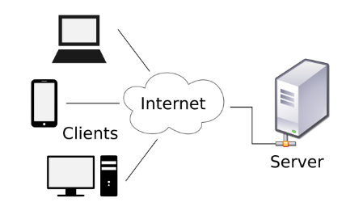
APIs vs Other Software Architectures
Client-Server Architecture
2 major entities → a server and multiple clients
Server has resources (data, files or services) and processes client requests and responds back accordingly
Client requests the server for a particular resource

Slide 7
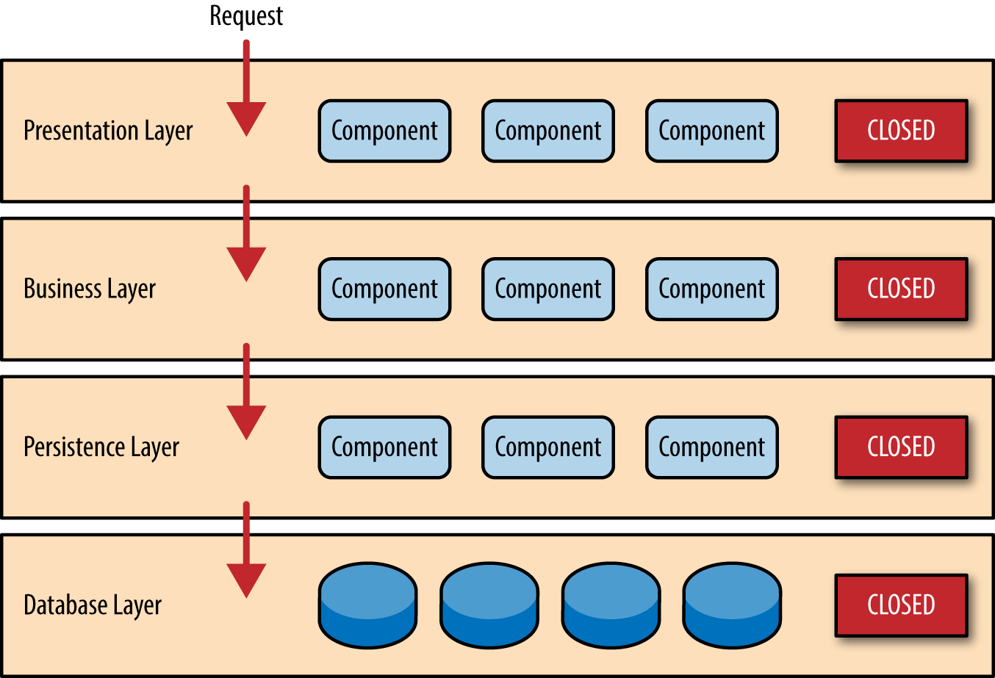
APIs vs Other Software Architectures
Layered Architecture
Presentation layer- UI layer where we see and enter data into an application
Business layer- responsible for executing business logic per request
Application layer- acts as a medium for communication between presentation layer and data layer
Data layer- has a database for managing data

Slide 8
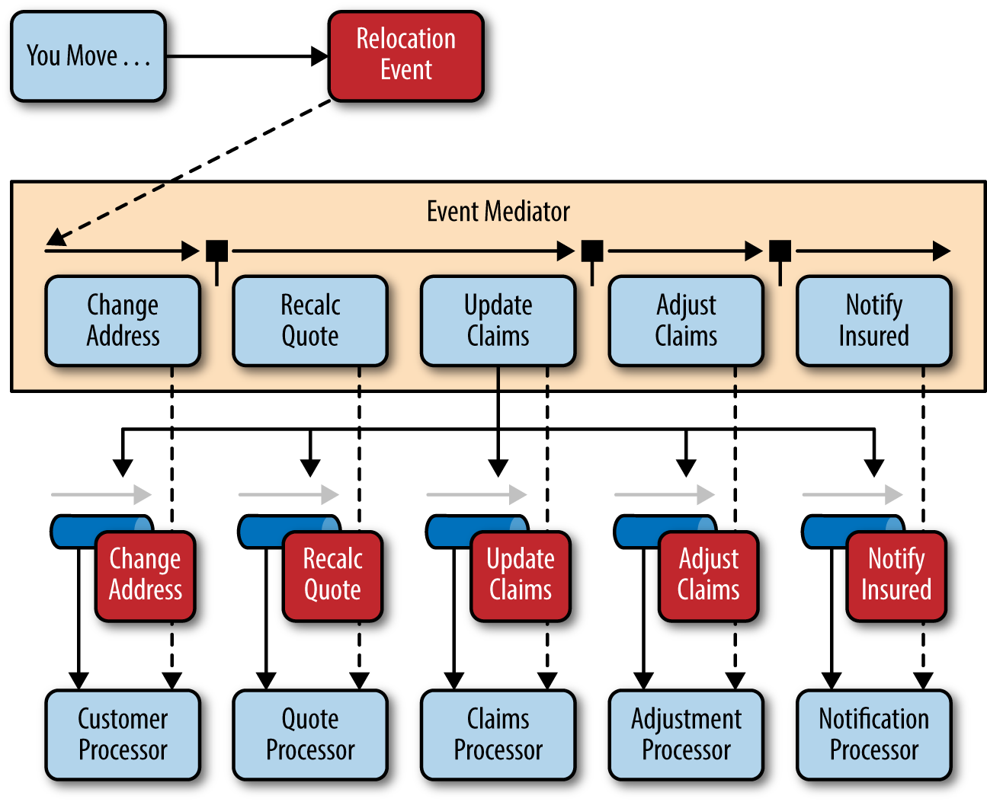
APIs vs Other Software Architectures
Event-Driven Architecture
Agile approach in which services (operations) of the software are triggered by events
When a user takes action in the application built using the EDA approach, a state change happens and the reaction that is generated is called an event.

Slide 9
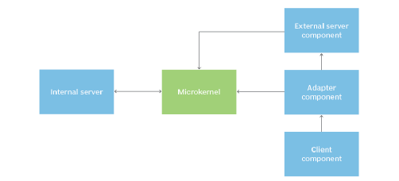
APIs vs Other Software Architectures
Microkernel Architecture
Contains 2 major components
The core system handles the fundamental and minimal operations of the application.
The plug-in modules handle the extended functionalities (like extra features) and customized processing.

Slide 10
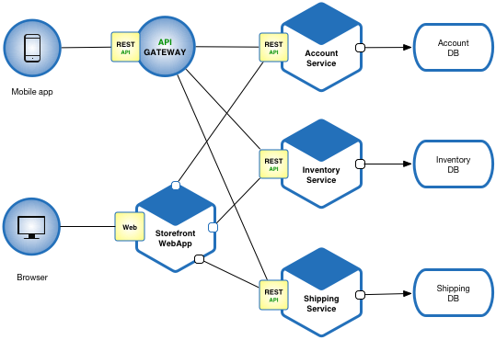
APIs vs Other Software Architectures
Microservice Architecture
The collection of small services that are combined to form the application
Instead of building a bigger application, small programs are built for every service (function) of an application independently and are further bundled together to be a full-fledged application.
Modules are loosely coupled → easily understandable, modifiable and scalable

Slide 11
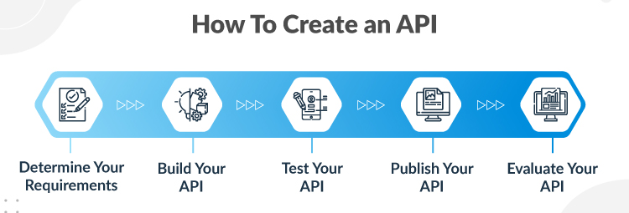
Necessary Steps for the Creation of an API
1. Plan the API
Provide the API specifications/ blueprint for API design.
Plan out different use cases in advance.
Ensure the API adheres to current API development standards.
2. Build the API
API designers prototype APIs using boilerplate code.
3. Test the API
Must be done to prevent bugs and defects.
API testing tools can be used to strength test the API against cyber attacks.
4. Document the API
Is a guide to improve usability.
5. Market the API
Listing your API can allow monetization for it.

Slide 12
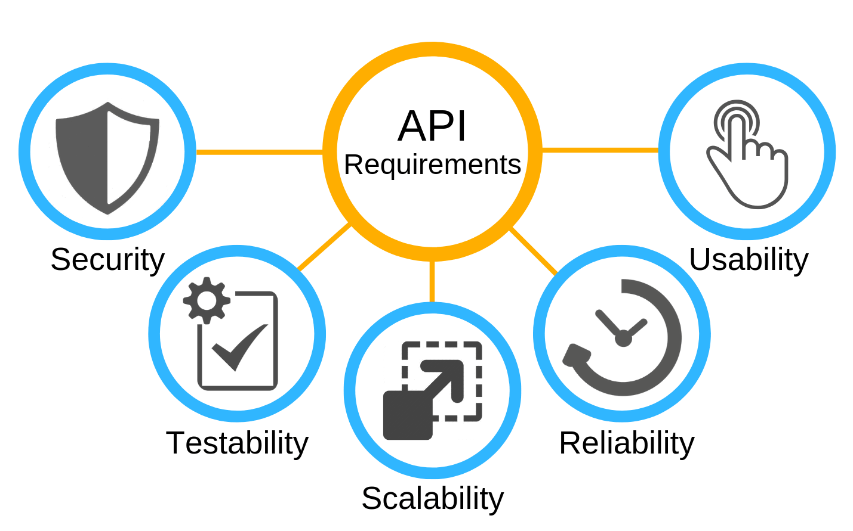
Necessary Components for the Creation of an API
Server Hosting: to function as an entry point between users and online data.
Reason: API retrieves data online and displays it to users.
Database Connection: application will make an API call for a set of data to display for the end user to consume.
The request is made via the API that accesses the web server to retrieve the requested data, which is populated in the user interface.
DB: not necessary
Data Protection: properly manage data privacy settings of API to protect information sent from APIs
Encrypt transmitted API messages
Programming Language: Can be written in any programming language.

Slide 13
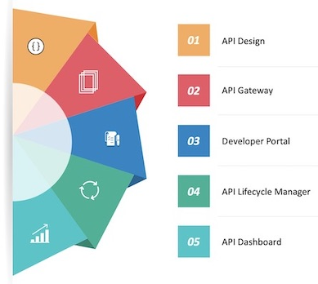
Necessary Components for the Management of an API
1. API Testing Environment
Functional testing
Performance testing
Acceptance testing
2. API Gateway
Acts as a messaging administrator.
Intercepts an API call, forwards it to the appropriate API, and handles the responses.
3. API Documentation
Reference documentation
Example documentation
Tutorial documentation
4. API Developer Portal
Storefront: developer & API
Provide human readable guides that describe what the API does, tutorials with step-by-step use instructions and SDKs that help developers integrate with the APIs.

Slide 14




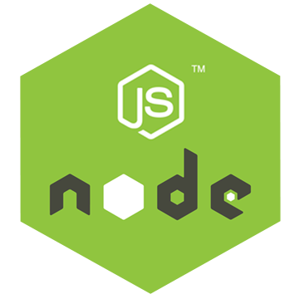


Technology Stack Choices for Building an API
Option 1
Programming Language - Golang
Frameworks - Reactjs
Web Servers - Apache HTTP server
Databases - Postgresql
Option 2
Programming Language - Javascript/Node Js
Frameworks - Expressjs
Web Servers - Nginx
Databases - Postgresql

Slide 15





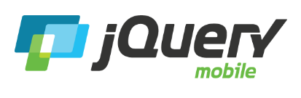
Frontend Choices (Mobile/Web)
React- web
Vuejs- web & mobile
React Native- mobile
Flutter- web but can be used for bringing existing mobile app to the web.
jQuery- web
jQuery Mobile- mobile

Slide 16

Security Considerations
Implement authentication
Implement authorization
Validate all requests
Encrypt all requests and responses
Only include necessary information in responses
Throttle API requests and establish quotas
Log API activity
Conduct security tests

Slide 17
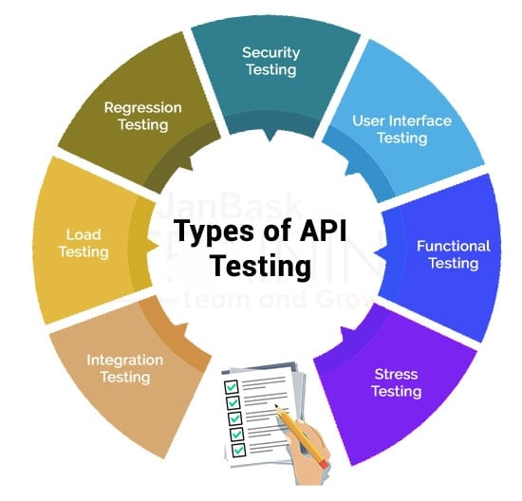
What is API Testing?
Validates server responses.
APIs lack a GUI → API testing is performed at the message layer.
Testing strategies include:
Making multiple requests to API endpoints for performance testing.
Writing unit tests for checking business logic and functional correctness.
Security testing by simulating system attacks.

Slide 18
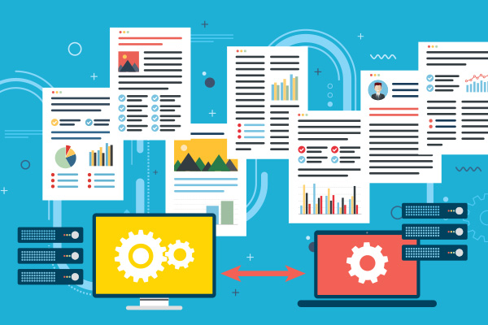
API Documentation
Can assist developer with knowing how to operate the API.
Crucial for API management.
API documentation strategies include:
Writing simple explanations.
Using code samples to explain functionality.
Maintaining the documentation so it is accurate and up-to-date.
Covering all the problems the API assist with.

Slide 19
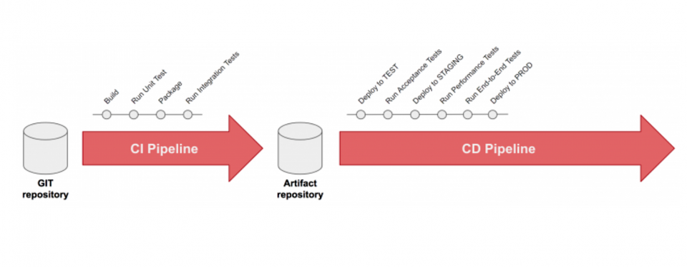
Deployment
Some platforms to deploy APIs include:
Docker
Amazon API Gateway
Azure
Heroku
Digital Ocean
Some general principles of API deployment include:
Use a contract-first approach
Ensure the testability of your API
Adhere to the semantic versioning
Be idempotent
Apply the API-Management-as-Code principles
API Deployment Steps:
Prepare release
Deploy API
Test API
Release API

Slide 20
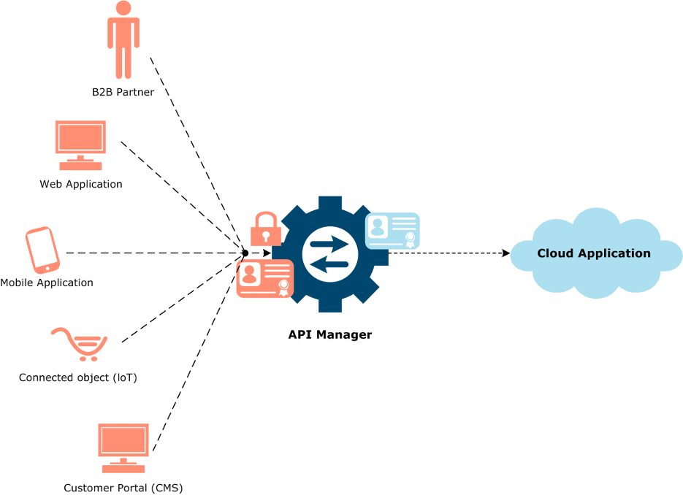
How to Use an API?
The following steps are required to implement a new API:
Obtain an API key by creating a verified account with an API provider.
Set up a HTTP API client: you can structure API requests by using the API keys received.
If you don't have an API client, you can structure the request in your browser using the API documentation provided on the page of the specific API you are using.
After you are familiar with the APIs syntax, you can start implementing it into your code/program.

Slide 21
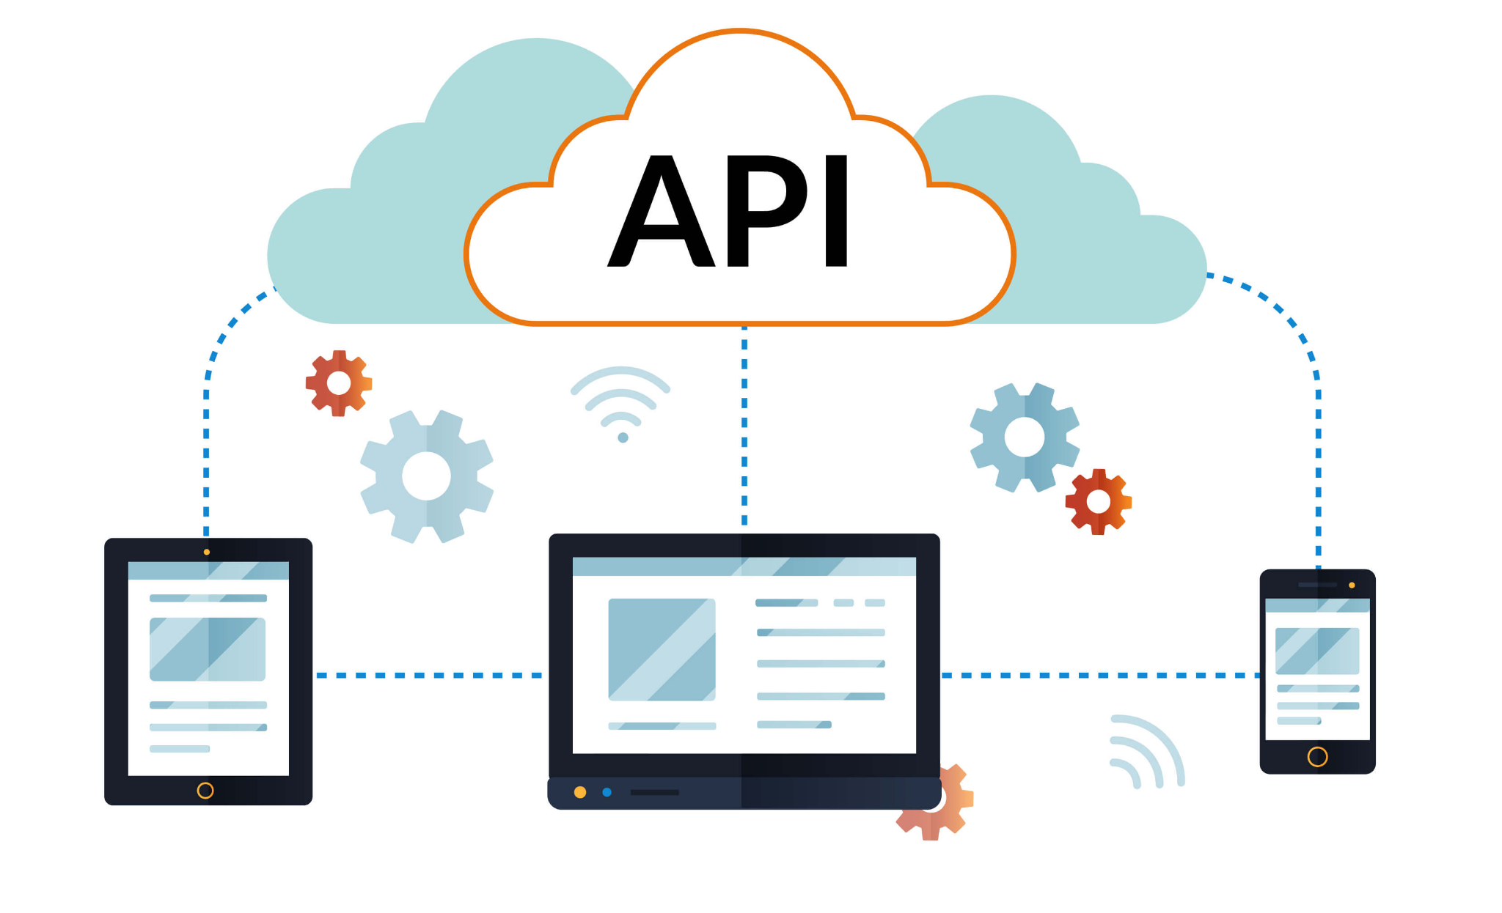
Lessons Learnt about APIs After Taking the Course
Proper API Development
Further Understanding on API Architecture
REST API type
Golang & its syntax
Learn how to use the JSON format in web APIs
Learn how to create models and middleware that interconnect with each other to perform a task
Learn how to Perform SQL migrations
Learn how to use email testing tools (MailTrap)

Slide 22
Conclusions
Joanne’s Challenges & Learning Outcomes
Zion’s Challenges & Learning Outcomes
Challenges:
Testing user permission rights → confusion with which user tokens were authenticated/ authorized
Removing data race bugs → args functionality kept on giving an unknown error due to IDE version
Learning Outcomes
Importance of managing database to view which users had what permission rights (for testing)
Importance of documentations
How REST functions work with handlers to give the API proper functionality
Challenges:
Virtual machine errors → several times my virtual would get corrupted or the media it’s on crashes.
Finding Time to watch the videos → A total 25 hours and 12 minutes of videos were. Not an easy task with a busy schedule
Learning Outcomes
Importance of an API when developing applications in 2022
Proper user creation, verification and authentication
Development in GO

Slide 23
Further API Implementations/ Research
API MANAGEMENT
CACHING
SOAP APIs
LOGGING API ACTIVITY
Creating and publishing web application programming interfaces
Enforcing usage policies
Building an infrastructure for distributed caching
Specifically memory application caching or database caching
Learn about the instances of when to use SOAP APIs over REST APIs.
Learn how they are structured and built, as well as the similarities and differences of REST.
Know how to include activity log/tracking so that it can be used to analyze the pattern of user actions and gather metrics from the API.

Slide 24
References
Amazon. (2022). What is ... Amazon. Retrieved December 4, 2022, from https://aws.amazon.com/what-is/api/#seo-faq-pairs#what-are-the-different-types-of-apis
Bigelow, S. J. (2021, February 8). What are the types of apis and their differences?: TechTarget. App Architecture. Retrieved December 8, 2022, from https://www.techtarget.com/searchapparchitecture/tip/What-are-the-types-of-APIs-and-their-differences
Jena, S. (2021, October 27). Types of software architecture patterns. GeeksforGeeks. Retrieved December 4, 2022, from https://www.geeksforgeeks.org/types-of-software-architecture-patterns/
Juviler, J. (2022, June 14). 8 API security best practices to protect sensitive data. HubSpot Blog. Retrieved December 8, 2022, from https://blog.hubspot.com/website/api-security
Massé, N. (2019, August 6). 5 principles for deploying your API from a CI/CD pipeline. Red Hat Developer. Retrieved December 8, 2022, from https://developers.redhat.com/blog/2019/07/26/5-principles-for-deploying-your-api-from-a-ci-cd-pipeline#overarching_principles_to_deploy_your_api_from_a_ci_cd_pipeline

